Slide 1
DESIGN AND ANALYSIS OF ALGORITHMS
LECTURE ONE

Slide 2
BASIC CONCEPT OF ALGORITHMS
LECTURE ONE

Slide 3
INTRODUCTION OF ALGORITHMS
Algorithms are structured sets of instructions designed to solve specific problems or perform particular tasks.
They function through a series of well-defined steps, each contributing to the ultimate goal.

Slide 4
TYPICAL STAGES INVOLVED IN THE FUNCTIONING OF AN ALGORITHM
Input. The first step involves defining the inputs that the algorithm will use. Inputs are the data on which the algorithm will operate. It could be anything from a single value to a complex data structure.
Processing. This is the core phase where the algorithm performs operations on the inputs using a series of computational steps. This phase is guided by logical and arithmetic calculations to process the data effectively. Within the processing phase, there are often crucial sub-steps:
Decision making. At various points during processing, decisions need to be made based on certain conditions. This substep involves directing the flow of the algorithm based on conditional statements, leading to different paths in the algorithm.

Slide 5
TYPICAL STAGES INVOLVED IN THE FUNCTIONING OF AN ALGORITHM
ii. Looping. For many algorithms, certain steps need to be repeated multiple times until a specific condition is met. Looping allows the algorithm to execute the same steps repeatedly, optimizing the process and saving time.
Output. After processing the inputs through various computational and conditional steps, the algorithm produces an output. This output is the result of the algorithm’s operations and is used to solve the problem or perform the task at hand.
Termination. An algorithm must have a defined stopping point to ensure it doesn’t run indefinitely. Once all the steps are executed successfully, and the output is produced, the algorithm reaches its termination point.

Slide 6
ALGORITHM DEVELOPMENT STEPS
The process of algorithm development generally involves many steps.
The general steps involved in algorithm development are as follows: -
Problem Definition
Problem Analysis
Algorithm Design
Flowchart
Implementation
Testing
Documentation

Slide 7
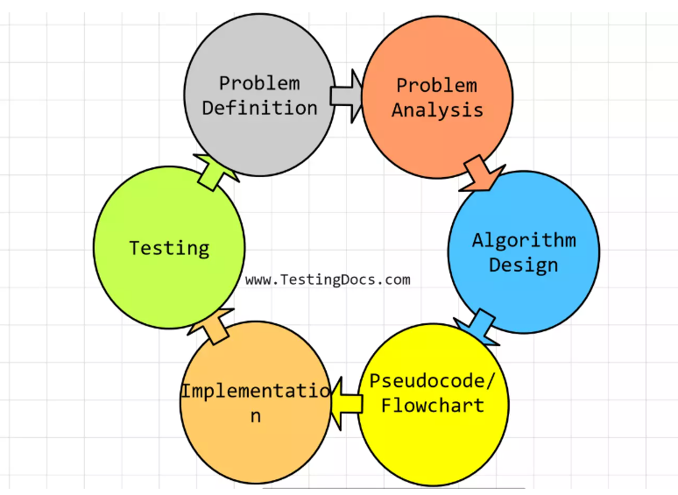
ALGORITHM DEVELOPMENT STEPS

Slide 8
ALGORITHM DEVELOPMENT STEPS
💡Problem Definition
Clearly define the problem that the algorithm needs to solve. Clearly understand the problem statement so that a proper algorithm can be designed. This stage includes understanding the input data, desired output, and constraints or requirements.
✍🏼 Problem Analysis
Analyze the problem to understand its characteristics, complexity, and potential solutions. This may involve studying the data, identifying patterns, understanding the relationships between variables, and considering different approaches..

Slide 9
ALGORITHM DEVELOPMENT STEPS
🛠️ Algorithm Design
Based on the problem analysis, design an algorithm that outlines the step-by-step process for solving the problem. This may involve selecting appropriate data structures, choosing suitable problem-solving techniques, and designing tools for defining the logic or flow of the algorithm.
👩🏻‍💻 Flowchart Development
A flowchart is a visual representation of the algorithm so that it is easy to understand. Create a high-level representation of the algorithm using flowcharts. Flowcharts use graphical symbols to represent the steps and flow of the algorithm.

Slide 10
ALGORITHM DEVELOPMENT STEPS
💻 Implementation
Translate the algorithm design into a specific computer programming language. Write the code to implement the algorithm, considering the programming language’s syntax, data types, and control structures.
🔎 Testing
Test the algorithm by giving the test data and see if the desired output is generated. Test with various inputs to verify the correctness and effectiveness of the algorithm. Identify and fix any bugs or errors that may arise during testing. Testing may involve different types of inputs, including edge cases, to ensure the algorithm performs correctly in different scenarios.

Slide 11
ALGORITHM DEVELOPMENT STEPS
📝 Documentation
Document the algorithm’s design, implementation details, and assumptions or limitations. This documentation helps others understand and use the algorithm effectively.

Slide 12
COMPLEX ALGORITHM DESIGN
Complex algorithm design may involve multiple iterations to redefine the development process. These stages are:
Evaluation
Iteration
Optimization

Slide 13
TYPES OF ALGORITHMS
We can categorize algorithms based on their use cases and their structural or problem-solving strategies.

Slide 14
ALGORITHM USE CASES
Search algorithms. Designed to retrieve information stored within some data structure, e.g., binary search algorithm used to find a particular item in a sorted list.
Sorting algorithms. They rearrange the elements of a dataset in a specified order, like quicksort and merge-sort, which are efficient for sorting large datasets.
Graph algorithms. These deal with graphs, which are mathematical structures used to represent pairwise relations between objects, e.g. Dijkstra's algorithm finds the shortest path between nodes in a graph.

Slide 15
STRUCTURAL OR PROBLEM-SOLVING STRATEGIES
Dynamic programming algorithms. Implemented to solve problems by breaking them down into smaller subproblems, dynamic processing algorithms avoid redundant work by remembering past results, which is a technique called memorization.
Brute force algorithms. By trying all possible solutions until the correct one is found, brute force algorithms can be effective, but time-consuming for complex problems.
Recursive algorithms. These algorithms call themselves with smaller input values and use the results of these calls to solve the current problem. A classic example is the factorial function, where the factorial of a number n is calculated as n multiplied by the factorial of (n-1).

Slide 16
STRUCTURAL OR PROBLEM-SOLVING STRATEGIES
4. Greedy Algorithms. Greedy algorithms make locally optimal choices at each step with the hope of finding the global optimum. One example is the Huffman coding algorithm, used for lossless data compression.
5. Divide and conquer algorithms. These algorithms divide the problem into smaller subproblems, solve them independently, and then combine their solutions to solve the original problem. The merge sort algorithm is a classic example of a divide and conquer strategy.
6. Backtracking algorithms. They work by trying different solutions and backtracking to find the correct solution when a dead end is reached. Sudoku solvers often use backtracking algorithms.

Slide 17
STRUCTURAL OR PROBLEM-SOLVING STRATEGIES
7. Randomized algorithms. Randomized algorithms use random numbers to make decisions during the execution, which means they can give different outputs on different runs. Quick-Sort is an example where randomization can be used to improve performance on average.

Slide 18
CATEGORIES OF ALGORITHMS
From the data structure point of view, following are some important categories of algorithms;
Search − Algorithm to search an item in a data structure.
Sort − Algorithm to sort items in a certain order.
Insert − Algorithm to insert item in a data structure.
Update − Algorithm to update an existing item in a data structure.
Delete − Algorithm to delete an existing item from a data structure

Slide 19
CHARACTERISTICS OF AN ALGORITHM
Unambiguous − Algorithm should be clear and unambiguous. Each of its steps (or phases), and their inputs/outputs should be clear and must lead to only one meaning.
Input − An algorithm should have 0 or more well-defined inputs.
Output − An algorithm should have 1 or more well-defined outputs, and should match the desired output.
Finiteness( must have start and the end) − Algorithms must terminate after a finite number of steps.
Feasibility − Should be feasible(or possible) with the available resources.
Independent − An algorithm should have step-by-step directions, which should be independent of any programming code

Slide 20
FUNDAMENTAL ANALYSIS OF ALGORITHMS EFFICIENCY
Efficiency of an algorithm can be analyzed at two different stages, before implementation and after implementation.
They are the following;
A Priori Analysis − This is a theoretical analysis of an algorithm. Efficiency of an algorithm is measured by assuming that all other factors, for example, processor speed, are constant and have no effect on the implementation.
A Posterior Analysis − This is an empirical analysis of an algorithm. The selected algorithm is implemented using programming language. This is then executed on target computer machine. In this analysis, actual statistics like running time and space required, are collected.

Slide 21
ANALYSIS OF ALGORITHMS EFFICIENCY
A Priori Analysis
A priori analysis, also known as theoretical analysis, includes evaluating the performance of an algorithm independently of any actual implementation. It is done purely on paper (or theoretically), based on the algorithm's logical structure.
A priori analysis is beneficial because it allows developers to calculate the scalability and efficiency of algorithms without the need to actually execute them on a computer.
This theoretical understanding is critical when comparing different algorithms or deciding on an algorithm before the implementation phase

Slide 22
ANALYSIS OF ALGORITHMS EFFICIENCY
A Posteriori Analysis
A posteriori analysis, in contrast, is an empirical analysis that includes implementing the algorithm and running it on a computer to measure its actual performance under specific conditions.
This type of analysis provides concrete data on how an algorithm performs in real-world scenarios.
A posteriori analysis provides practical insights that a priori analysis cannot, especially in terms of interaction with system architecture and actual execution dynamics

Slide 23
ALGORITHM COMPLEXITY
Algorithm complexity is a critical concept in DSA and computer science that describes the amount of computational resources that an algorithm requires to complete.
This understanding is important for optimizing algorithms to make them more efficient, especially when working with large datasets or in environments where resources are constrained

Slide 24
TYPES OF ALGORITHM COMPLEXITY
1. Time Complexity
Time complexity measures the amount of time an algorithm takes to complete as a function of the length of the input.
It is generally expressed in terms of the number of operations used by the algorithm, assuming that each operation takes a fixed amount of time.
Time complexity is critical for understanding how quickly an algorithm can solve a problem.
Notations used to express Time Complexity:
Big O Notation (O-notation)
Omega Notation (Ω-notation)
Theta Notation (Θ-notation)

Slide 25
TYPES OF ALGORITHM COMPLEXITY
Common Time Complexities:
O(1) (Constant Time):
The algorithm's execution time remains constant regardless of the input size.
O(log n) (Logarithmic Time):
The execution time grows proportionally to the logarithm of the input size. Binary search is a classic example.
O(n) (Linear Time):
The execution time grows directly with the input size.

Slide 26
TYPES OF ALGORITHM COMPLEXITY
Common Time Complexities:
O(n log n) (Log-Linear Time):
The execution time grows proportionally to n multiplied by log n. Many efficient sorting algorithms fall into this category.
O(n^2) (Quadratic Time):
The execution time grows proportionally to the square of the input size. Nested loops often result in quadratic time complexity.
O(2^n) (Exponential Time):
The execution time doubles with each increase in input size. Brute-force algorithms can lead to exponential time complexity

Slide 27
FACTORS AFFECTING TIME COMPLEXITY
Number of Operations: The number of basic operations (like comparisons, assignments, etc.) an algorithm performs.
Input Size: The size of the input data, often represented by 'n'.
Algorithm Design: The choice of algorithm and its underlying structure significantly impact time complexity.

Slide 28
TYPES OF ALGORITHM COMPLEXITY
2. Space Complexity
Space complexity measures the total amount of memory space required by an algorithm as a function of the input size.
It includes both the temporary space allocated by the algorithm during its execution and the space required for the input to the algorithm.
Optimizing space complexity is crucial when system memory is limited.
Examples of Space Complexity:
Constant Space (O(1))
Linear Space (O(n))

Slide 29
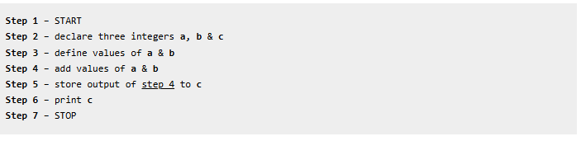
CHARACTERISTICS OF AN ALGORITHM
We write algorithms in a step-by-step manner, but it is not always the case. Algorithm writing is a process and is executed after the problem domain is well-defined. That is, we should know the problem domain, for which we are designing a solution.
Example 1
Problem − Design an algorithm to add two numbers and display the result.

Slide 30
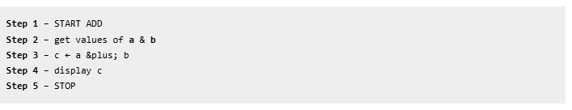
CHARACTERFUNDAMENTAL OF ALGORITHIMC PROBLEM SOLVINGISTICS OF AN ALGORITHM
Alternative algorithm

Slide 31
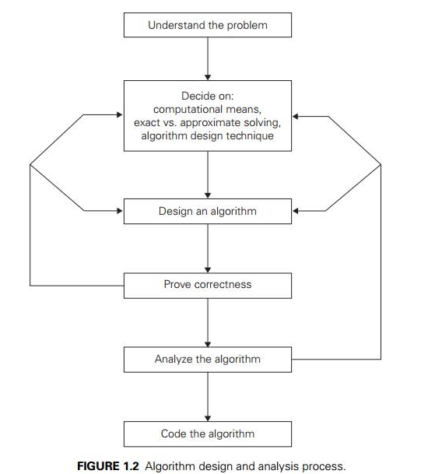
FUNDAMENTAL OF ALGORITHIMC PROBLEM SOLVING

Slide 32
IMPORTANT PROBLEM TYPES
In the realm of algorithmic problem solving there exists known important problem types that traverse various domain-specific problems.
These problem types are;
Sorting
Searching
String processing
Graph problems
Combinatorial problems
Numerical Problems

Slide 33
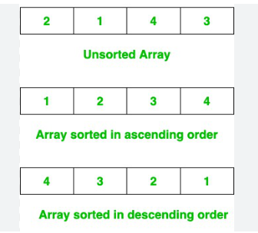
SORTING
The sorting problem requires one to arrange the elements of a list in ascending or descending order. The list input must allow such ordering.

Slide 34
SORTING
The sorting problem requires one to arrange the elements of a list in ascending or descending order. The list input must allow such ordering.
Examples of sorting algorithms include;
Bubble sort
Quicksort
Merge sort
Insert sort
Heapsort

Slide 35
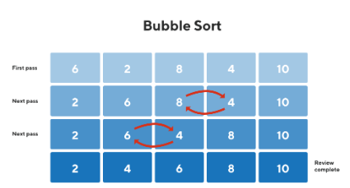
SORTING
Bubble sort is a simple sorting algorithm that works by repeatedly stepping through the list, comparing adjacent elements and swapping them if they are in the wrong order.

Slide 36
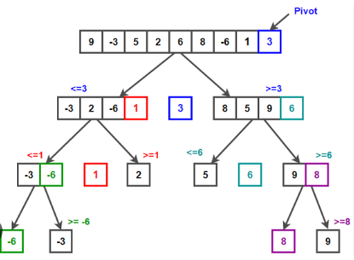
SORTING
Quicksort is a highly efficient sorting algorithm that employs a divide-and-conquer approach.
It works by selecting a "pivot" element and partitioning the array around it, placing smaller elements to the left and larger elements to the right.
This process is then recursively applied to the subarrays until the entire array is sorted.

Slide 37
SEARCHING
The searching algorithm deals with finding a given value(s) matching a search key in a given set of elements.
Examples of searching algorithms include;
Linear search
Binary search

Slide 38
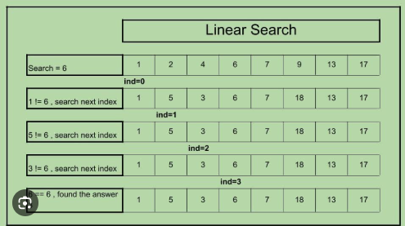
SEARCHING
A linear search algorithm finds a target value in a list by sequentially examining each element until a match is found or the end of the list is reached.

Slide 39
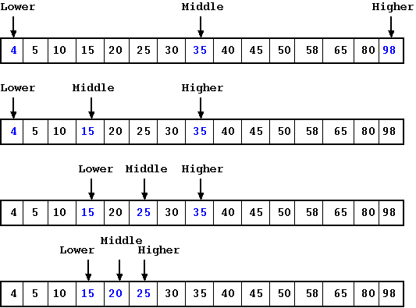
SEARCHING
Binary search is an efficient algorithm for finding an item from a sorted list of items.
It works by repeatedly dividing in half the portion of the list that could contain the item, until you've narrowed down the possible locations to just one.
We used binary search in the guessing game in the introductory tutorial.

Slide 40
STRING PROCESSING
A string is a sequence of characters from the alphabet.
String processing deals with finding a word in a given text. In recent years, there has been a proliferation of problems requiring the analysis of non-numeric data which has interested algorithm designers and data analysts.

Slide 41
GRAPH PROBLEMS
A graph is in simple terms a set of vertices connected by lines called edges.
Graphs evolve from linear data structures (i.e. linked lists which evolve from arrays)and push the boundaries of what the algorithm designers can utilize in the ADT (Abstract Data Types) set.

Slide 42
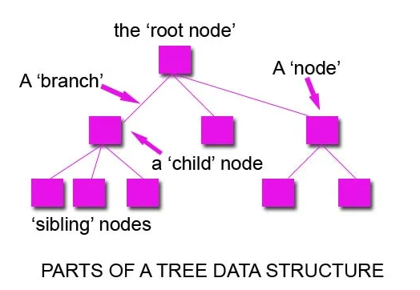
GRAPH PROBLEMS

Slide 43
COMBINATORIAL PROBLEMS
These are problems that require finding permutations, normally used to find complex optimizations such as minimizing cost or maximizing the value of efficiency. A clear example of a combinatorial problem is the travelling salesman problem.
Combinatorial problems are unique because of their potential for constantly increasing complex which can reach unimaginable levels. Also, most combinatorial problems do not as of yet have a solution.

Slide 44
GEOMETRIC PROBLEMS
These problems require the design of algorithms that deal with geometric objects such as lines, polygons, points and so on.
NUMERIC PROBLEM
These are problems that require the use of mathematics and mathematical principles of continuous nature. For instance, solving equations and systems of equations, computing definite integrals, evaluating functions and so on.

Slide 45
ANALYSIS FRAME WORK
There are two kinds of efficiency
Time efficiency - indicates how fast an algorithm in question runs.
Space efficiency - deals with the extra space the algorithm requires.

